Slide 1
Multi-Paths Concurrent Measurement Protocol
draft-dang-ippm-multiple-path-measurement-01
Joanna Dang dangjuanna@huawei.com,
Jianglong Wang wangjl1.bri@chinatelecom.cn

Slide 2
Overview
Charter for IPPM WG: produced protocols for communication among test equipment to enable the measurement.
Multiple Path Measurement [draft-dang-ippm-multiple-path-measurement-01] is mainly in concurrently measuring the multiple paths in equal-cost multi-path (ECMP) or unequal-cost multiple (UCMP) scenarios.

Slide 3
Multiple Paths
Src node
Dst node
A
N1
N2
B
Has a definite Src node and Dst node
Be Adopted in the equal-cost multi-path (ECMP) or unequal-cost multiple (UCMP) scenarios
N3
N4
N5
N6
Path1: A->N1->N2->B
Path2: A->N3->N4->B
Paht3: A->N5->N5->B
Each path of the multiple path are unidirectional.

Slide 4
Motivation
Path1: A->N1->N2->B
Path2: A->N3->N4->B
Paht3: A->N5->N5->B
Src node
Dst node
Service1
Src node
Dst node
Service1
Service2
A
N1
N2
B
A
N1
N2
B
Service3
N3
N4
N3
N4
N5
N6
N5
N6
Figure1: Senario1
Figure2: Senario1
Senario1: The services with different quality requirements is imported to the available paths on demand.
Senario2: There is a path congestion. The part of traffic causing the path congestion is adjusted to other light loads.
Challenge: Each path is measured separately in traditional method. If you want to ensure that the data obtained by the test is available and accurate, the test start point and end point in multiple paths must be consistent.
Solution: The Multi-Path Concurrent Measurement Protocol (MPCMP) is required.
Notes:
TSN 致力于一个converged network，就是承载 需要确定性低时延的流和BE流。。

Slide 5
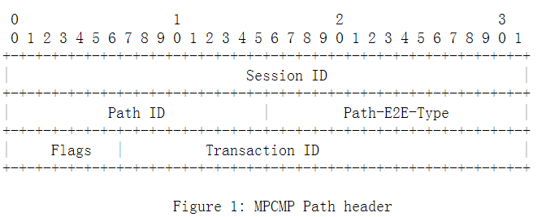
Multi-Path Concurrent Measurement Protocol
Sender
Receiver
The sender generate a multipath measurement at the same time.
Each path has its own query message.
Get the quality data of a multipath measurement at the same time through any path
The measurement results at the receiver can be sent back or sent in a sesponse message because the main consideration is to save network bandwidth.
Src node
Dst node
A
N1
N2
B
N3
N4
N5
N6
Query message in Path1
Query message in Path2
Query message in Path3
Response message
with Path1, path2 and path3 measurement info
Session ID: A set of multiple paths
Path ID: One path of the session.
Flags: Identify the query or response type.

Slide 6
Measurement Mode
Long-term measurement
The receiver can wait until it receives all measurement requests of a set of path and then responds.
Short-term measurement
The sender can query once t.
The receiver can reply once t.
P
1
P
2
P
1
P
3
P
2
P
3
Sender
Src node
Src node
P
1
P
1
P
2
P
3
P
2
P
3
Receiver
Dst node
Dst node
Tmax
Tmax
When the period is shorter, the measurement accuracy is higher.
Notes:
TSN 致力于一个converged network，就是承载 需要确定性低时延的流和BE流。。

Slide 7
Next Step
Think deeply in conjunction with Segment Routing Policy and In-situ OAM (IOAM) scenarios

Slide 8
Thank you!

